Slide 1

Microwave Popcorn
STAT571B Project
Spring 2016
Jimmy Thornton & Ken Youens-Clark

Slide 2

Problem Statement
The United States consumes 1B pounds of popcorn per year
Unpopped kernels lead to waste and unhappy consumers
What combination of microwave power setting and additives leads to least number of unpopped kernels?

Slide 3
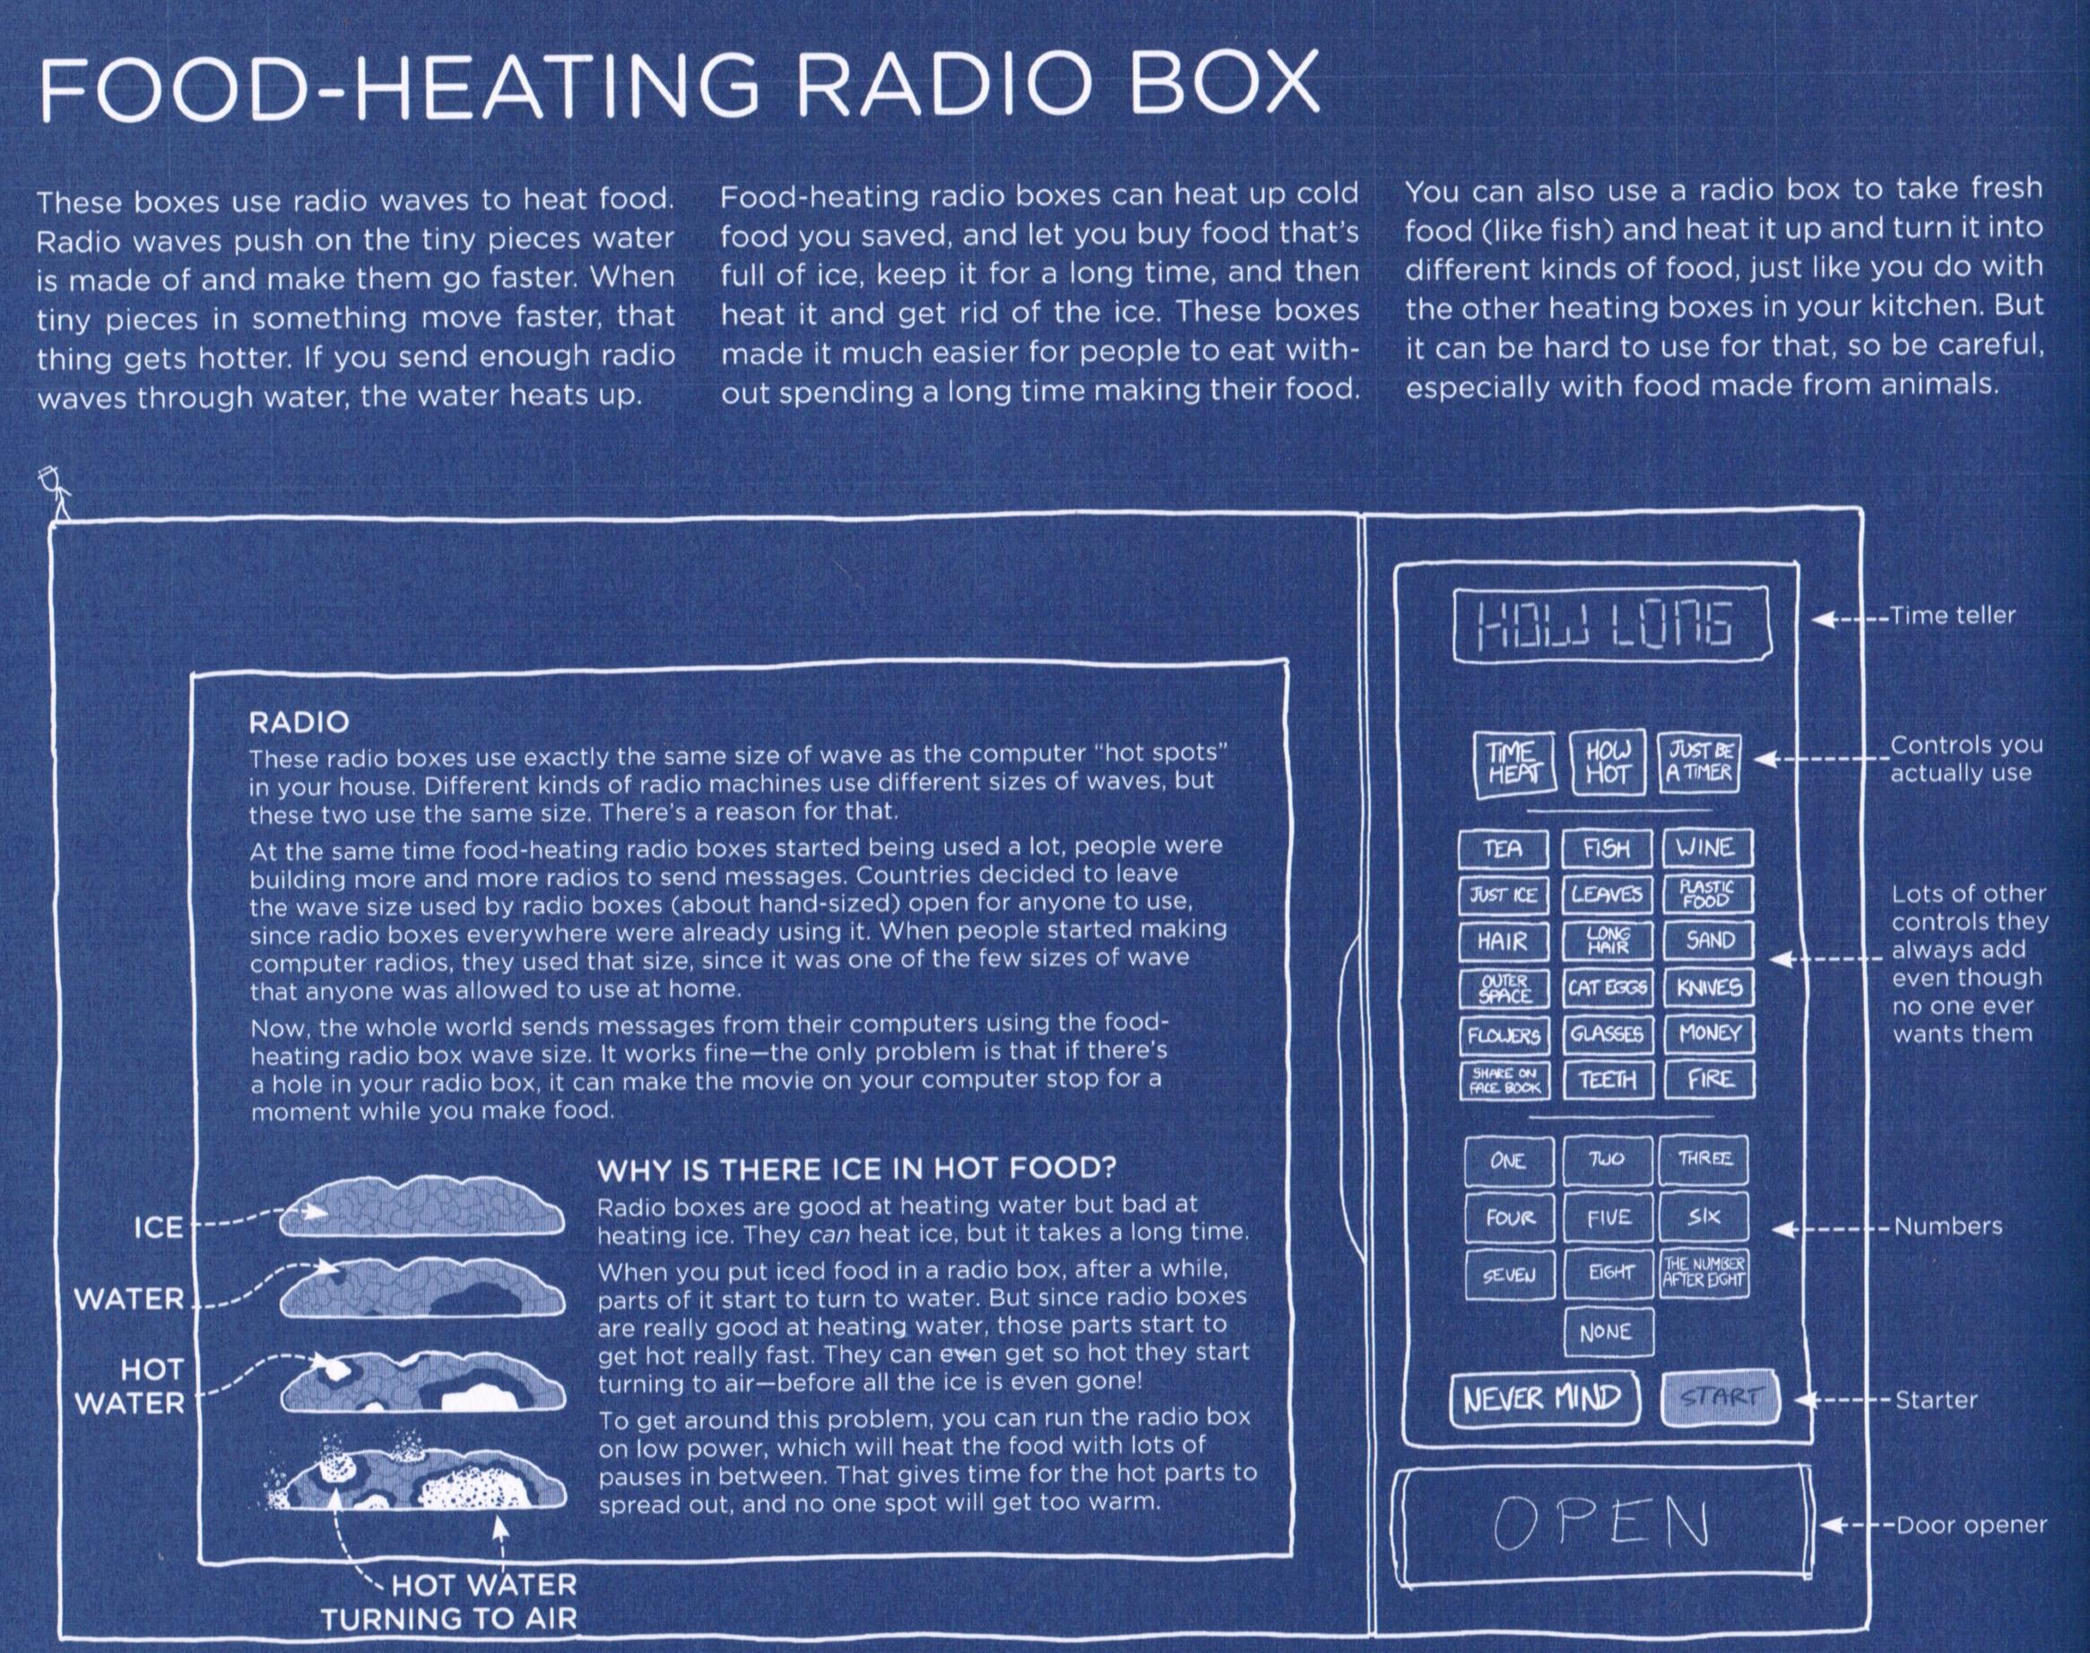
Thing Explainer, Randall Munroe

Slide 4
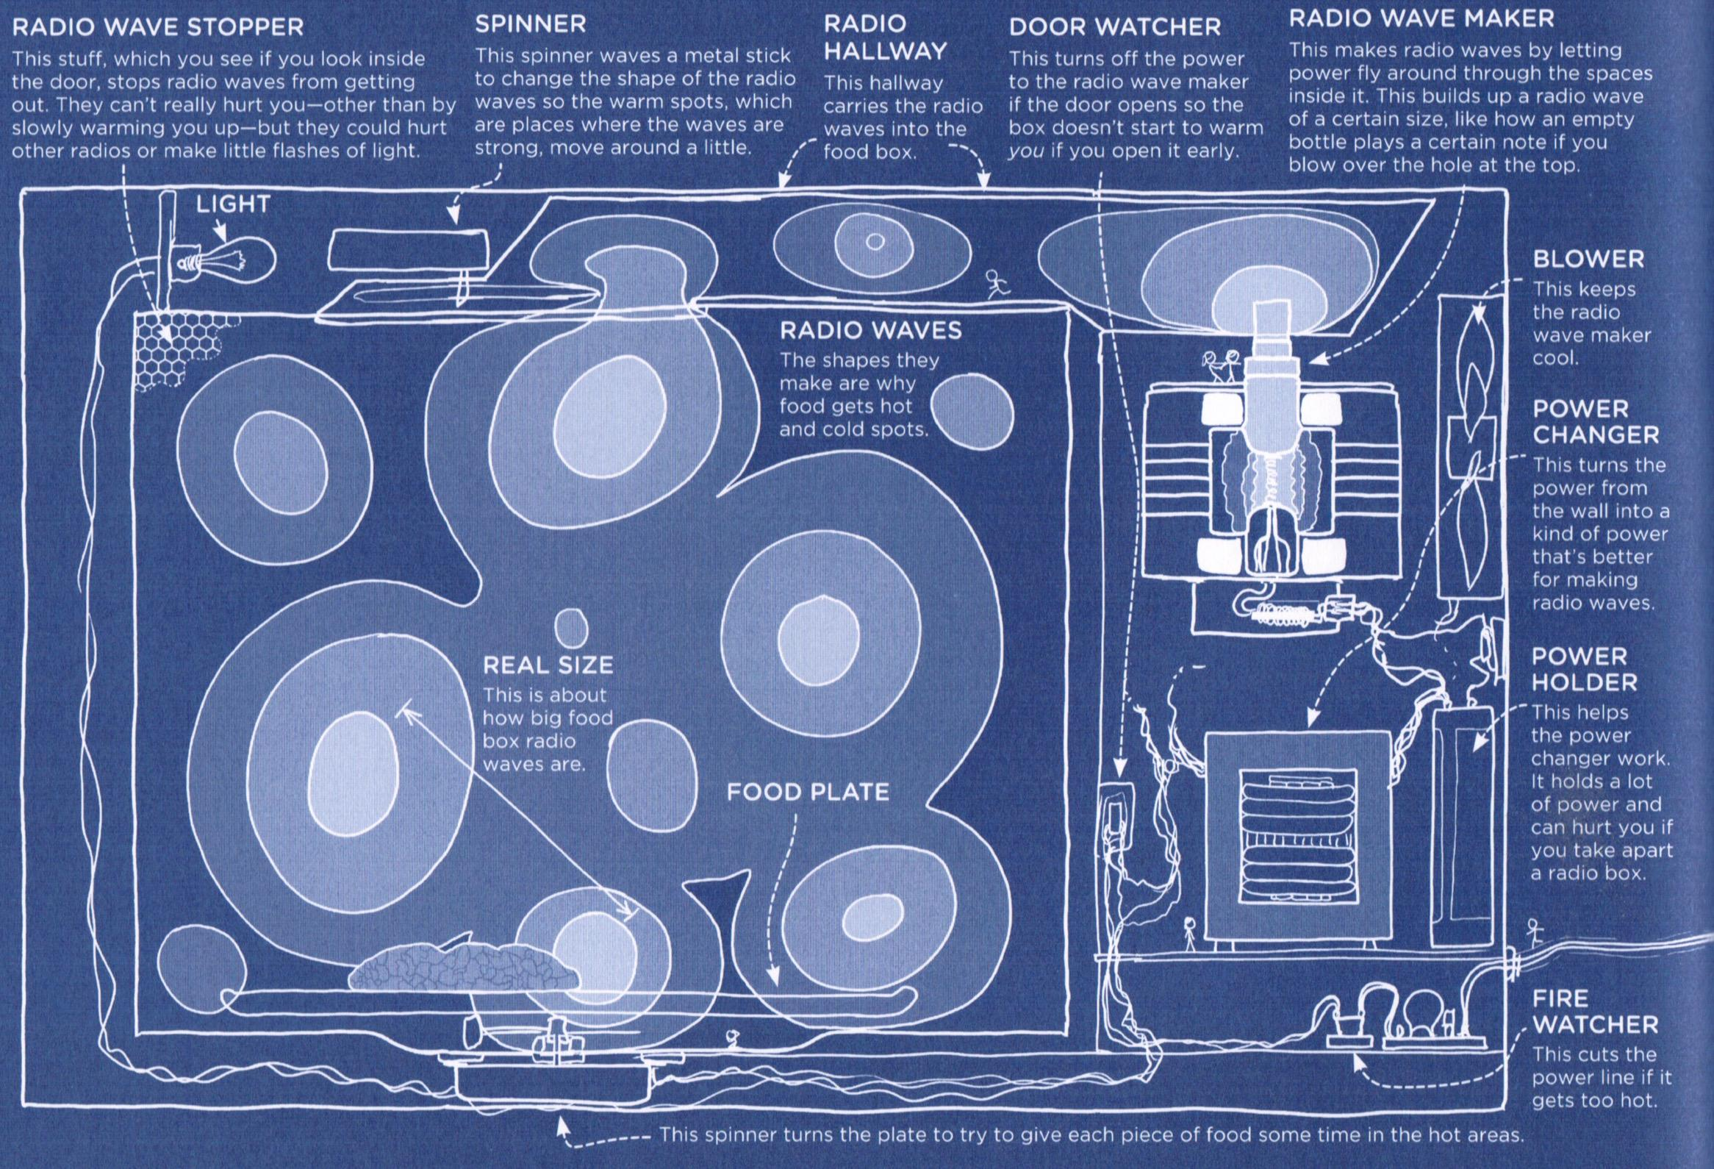

Slide 5
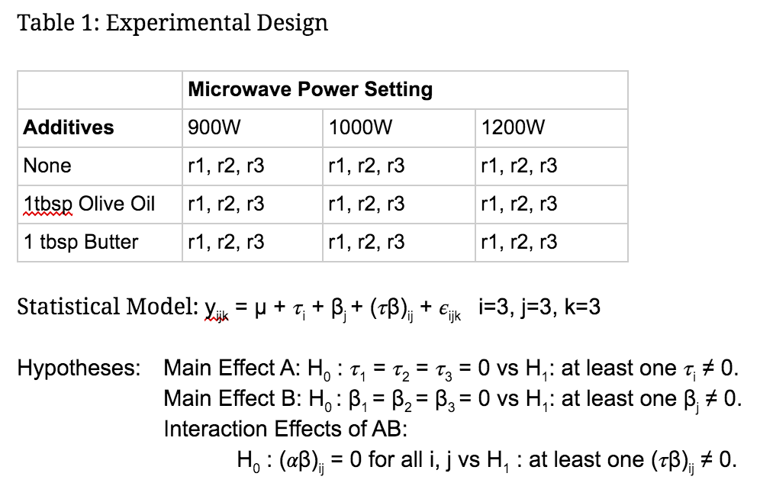
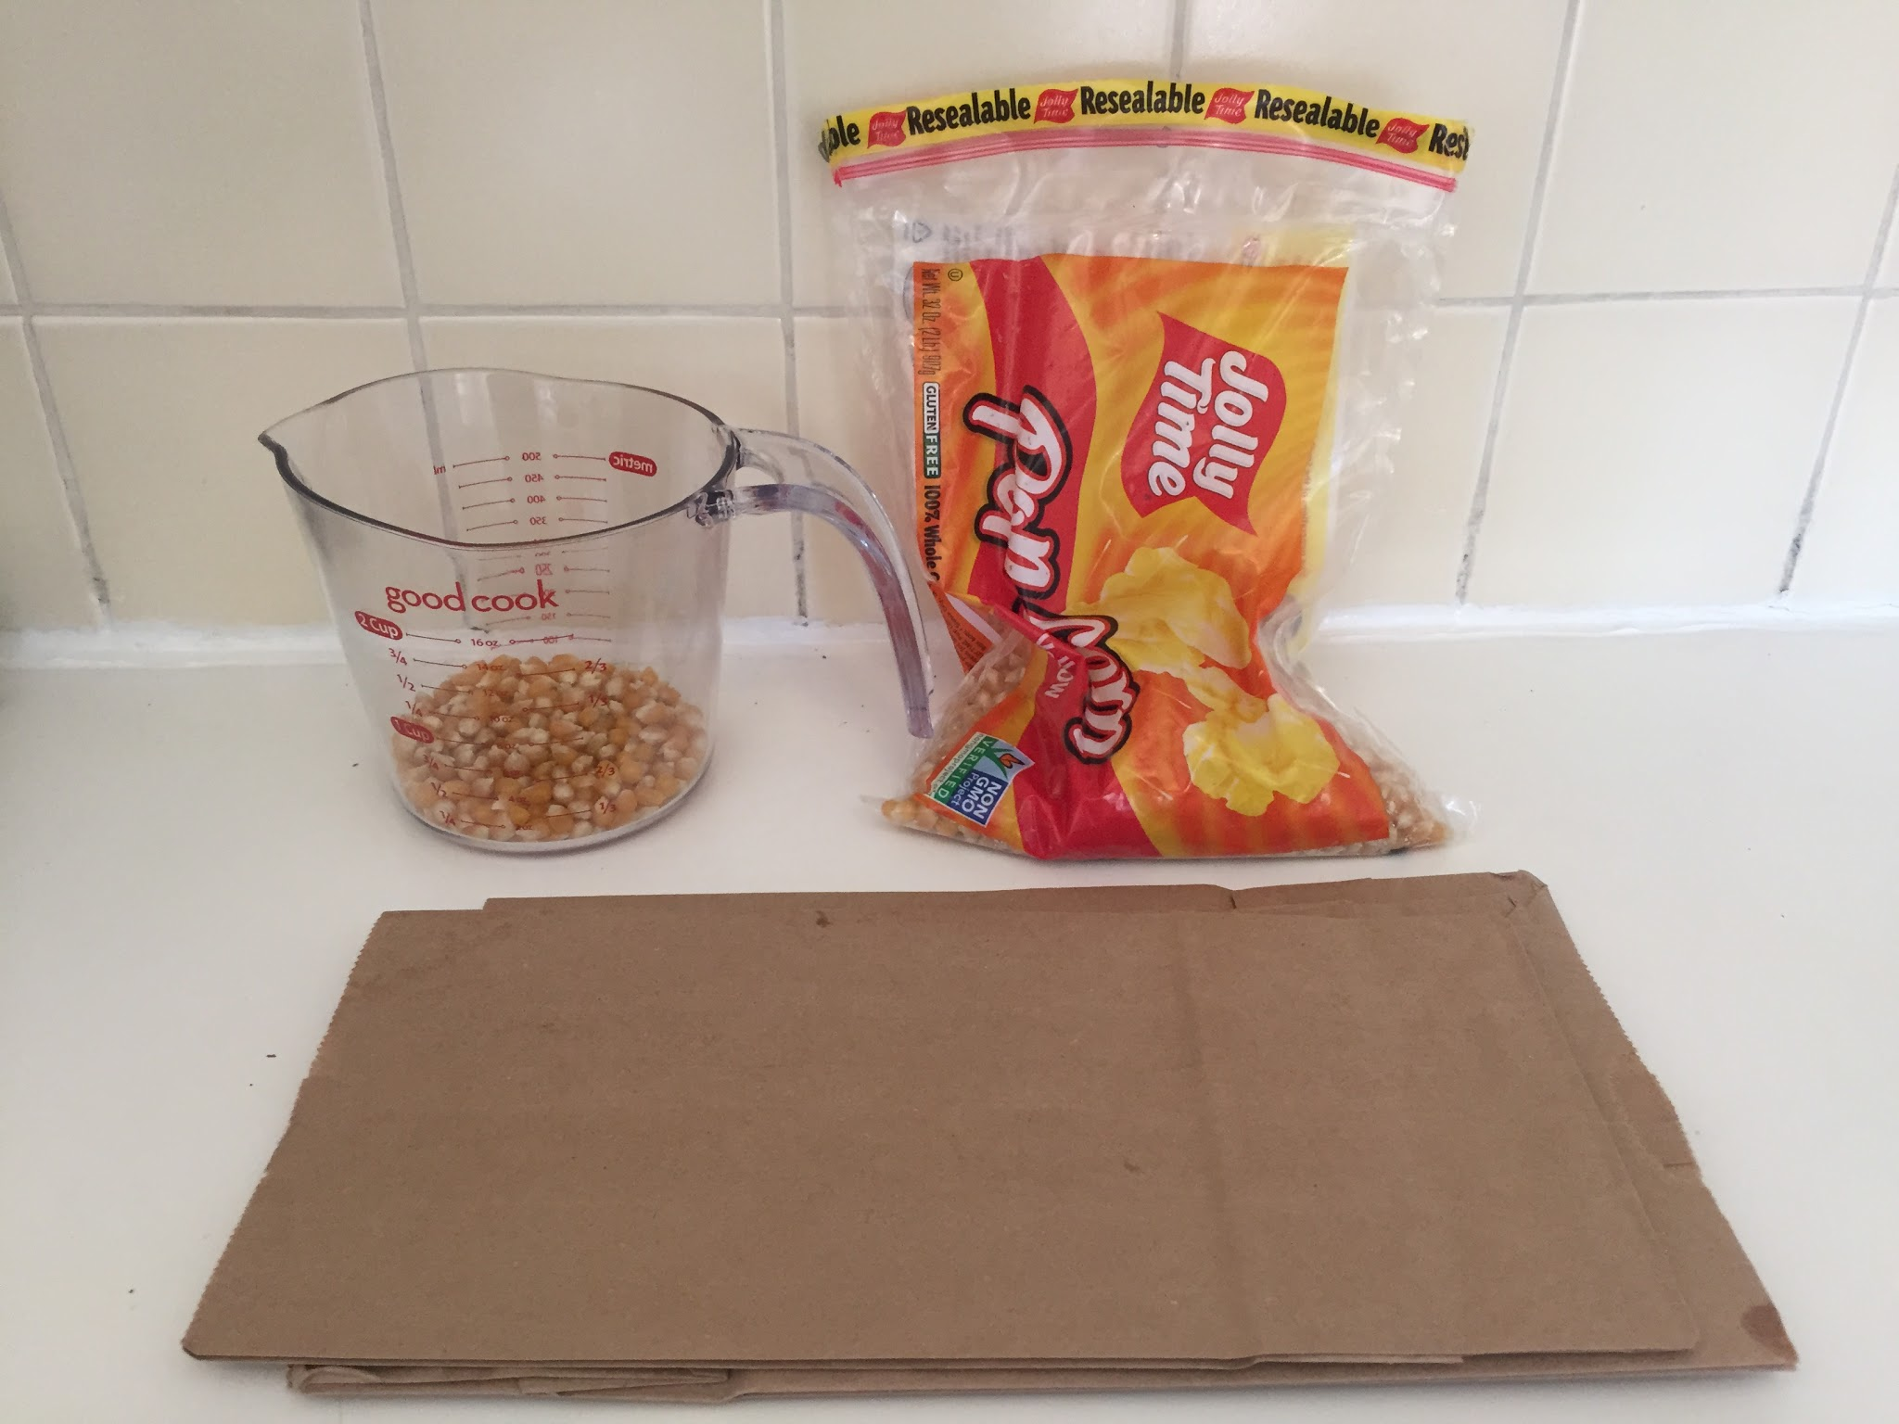
Design
2-factor fixed effect factorial

Slide 6
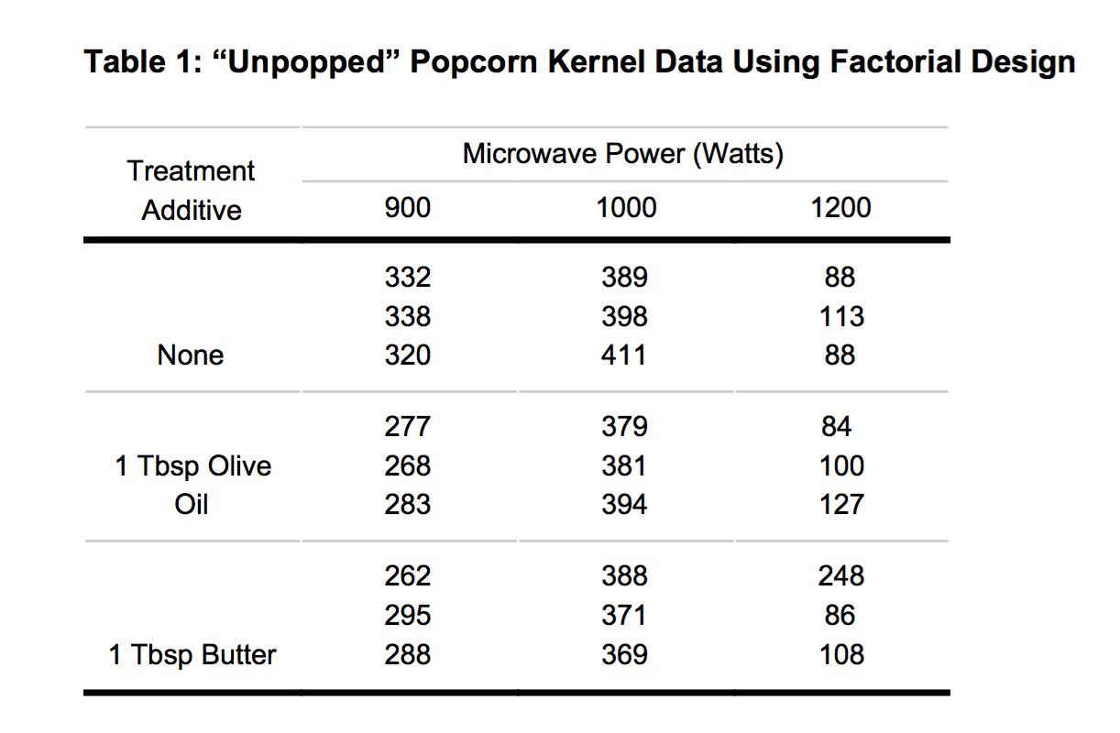
Data

Slide 7
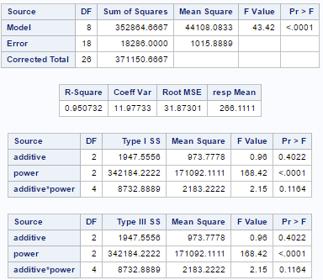
ANOVA

Slide 8
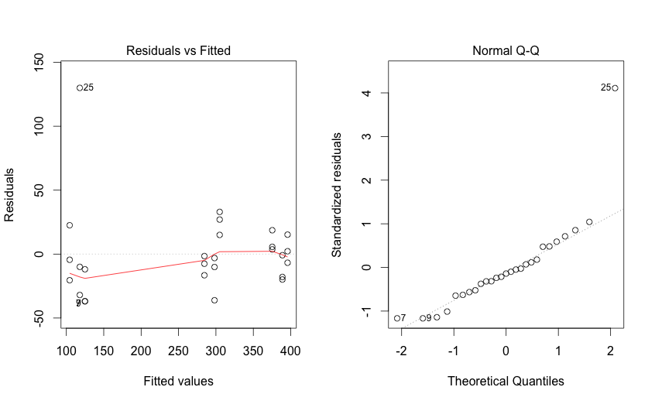
Normality

Slide 9
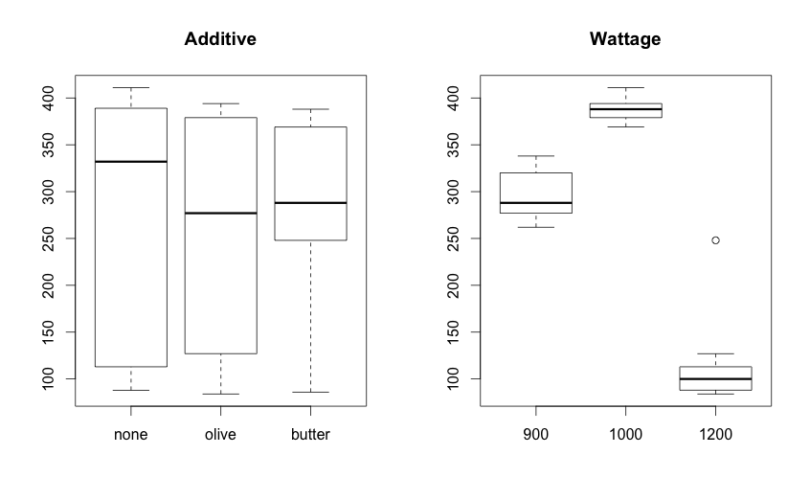

Slide 10
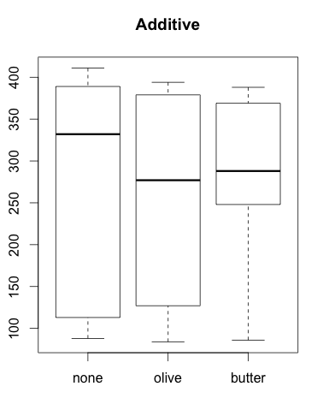
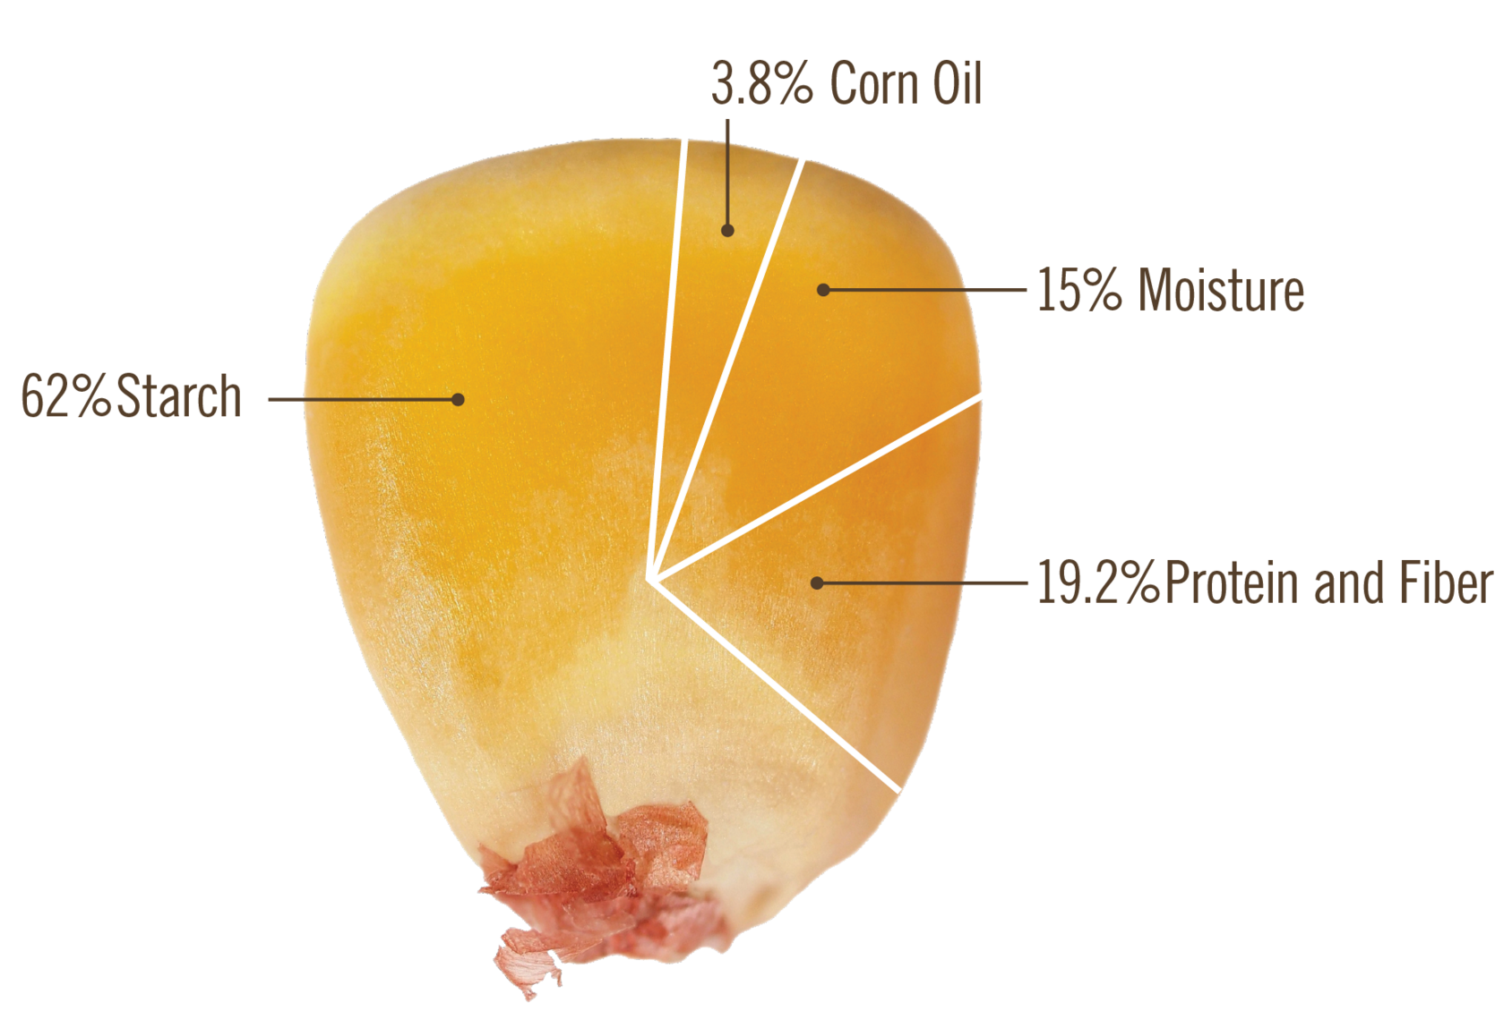
Additives
Expectation was that no additive would have more unpopped kernels, but this was wrong
No significant variation

Slide 11
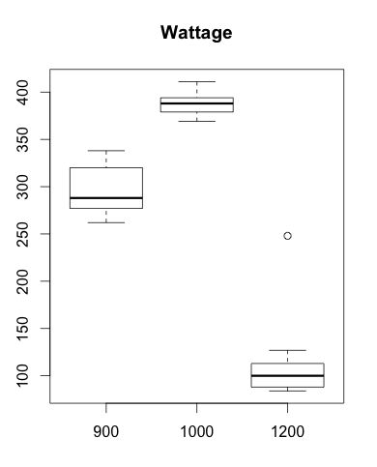
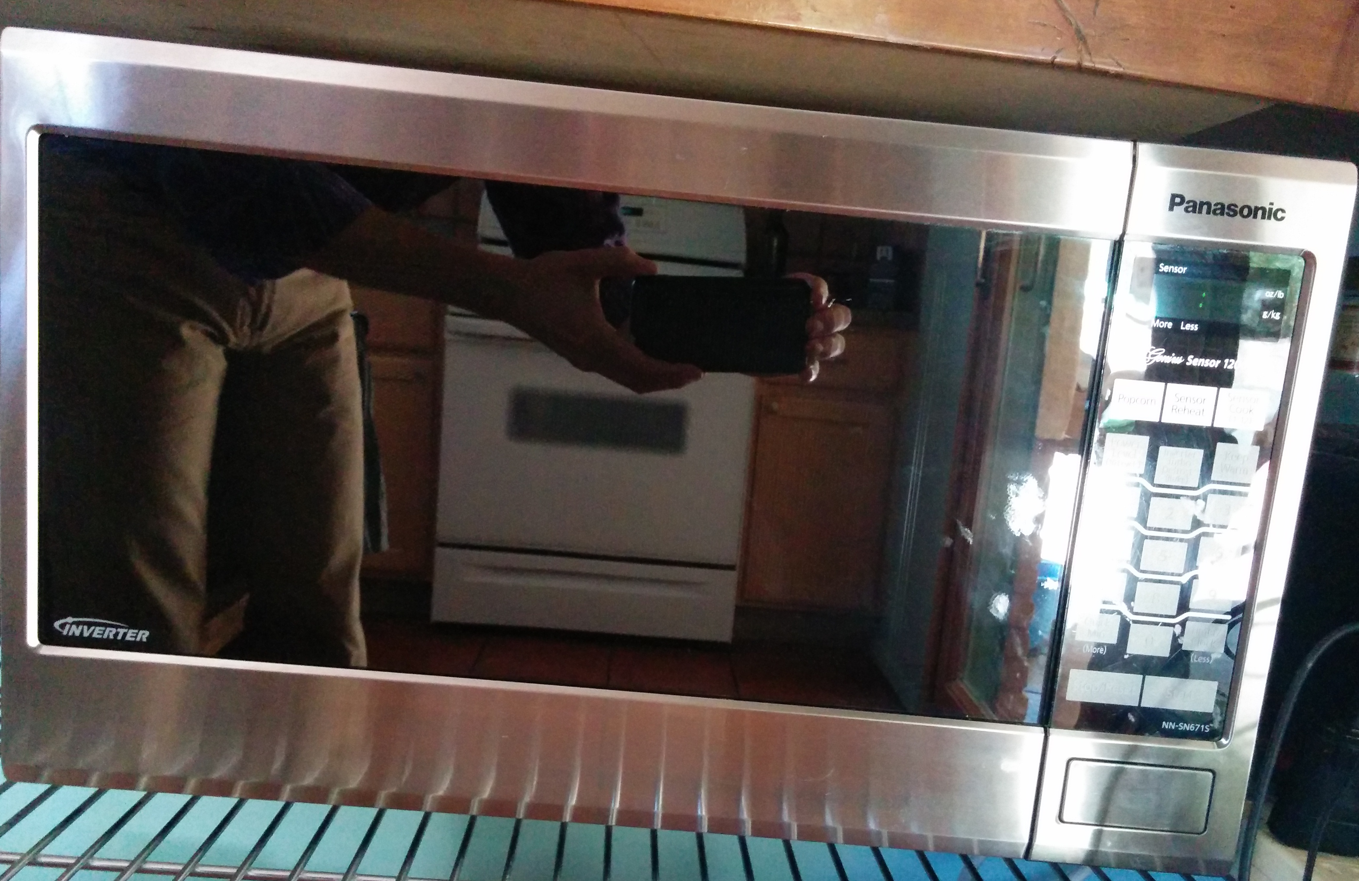
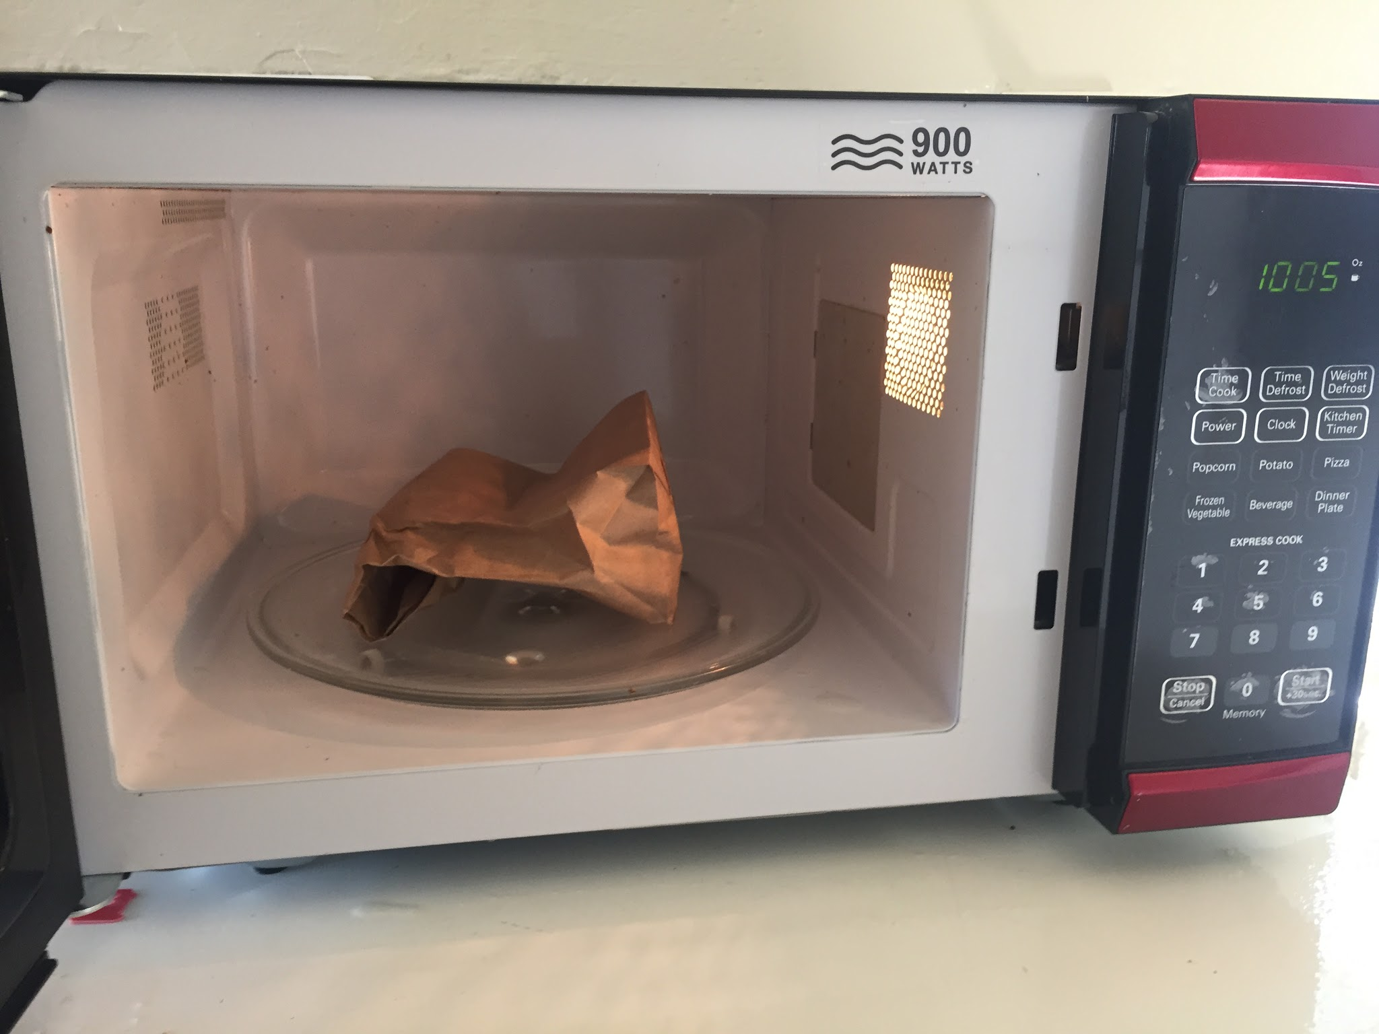
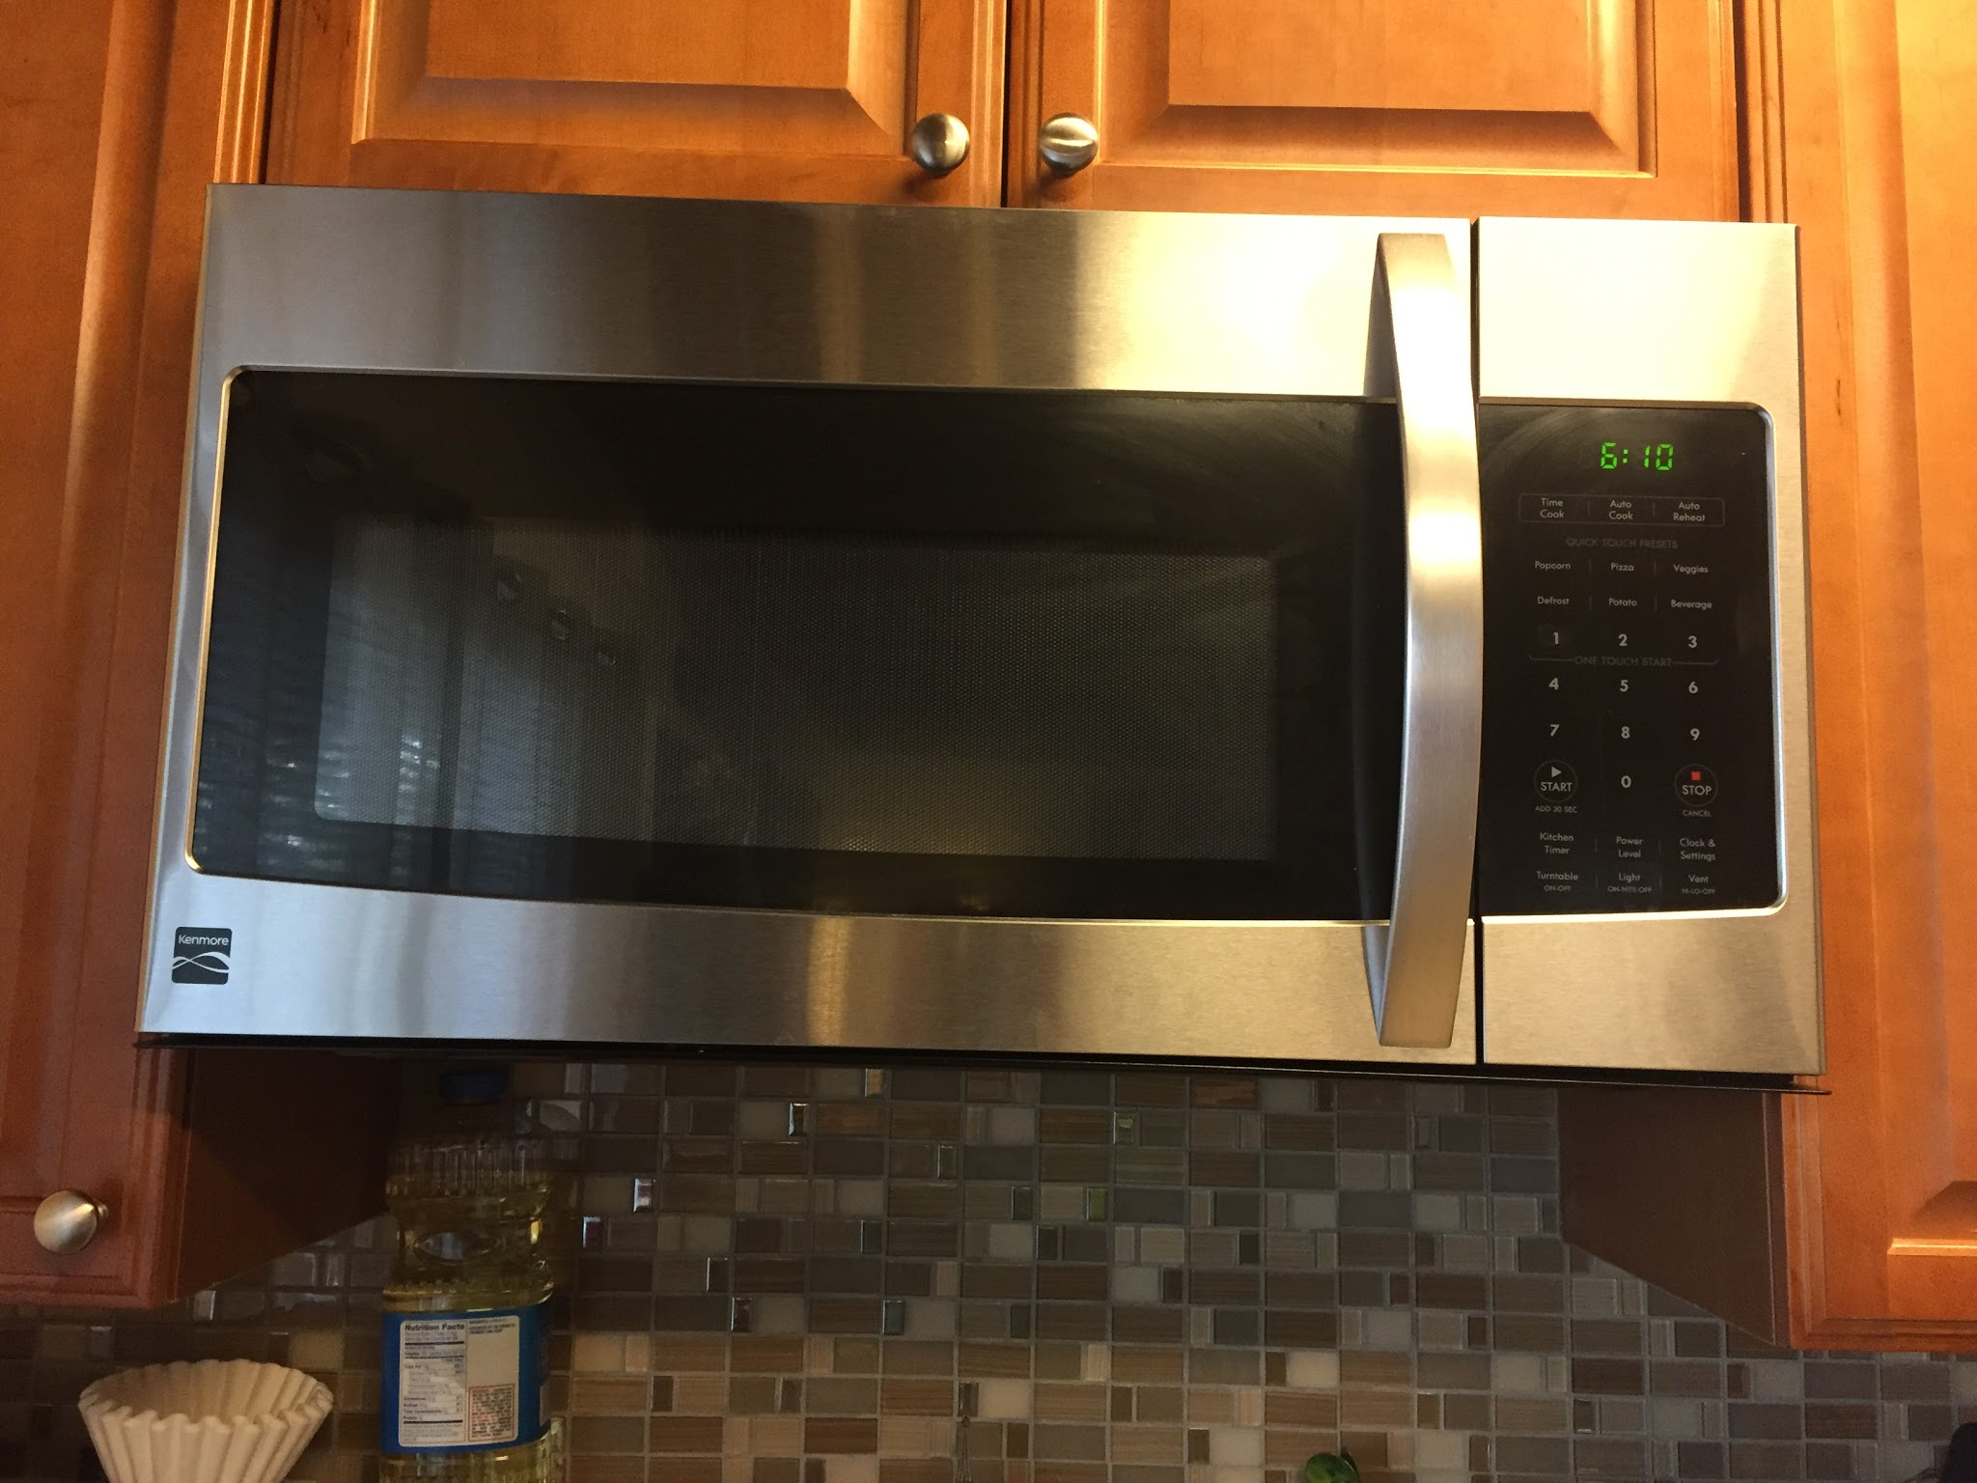
Microwaves/Power Factor
1200W: ~1 yo, Panasonic, best (Ken’s)
1000W: ~1 yo, worse (Jimmy’s sister)
900W: ~2 yo, Westgate, middle (Jimmy’s)
All ovens used a turntable
Significant variation

Slide 12
Potential Errors
Differences in ¼ cup ~ 400 kernels
Do older ovens work properly/can we trust wattage?

Slide 13
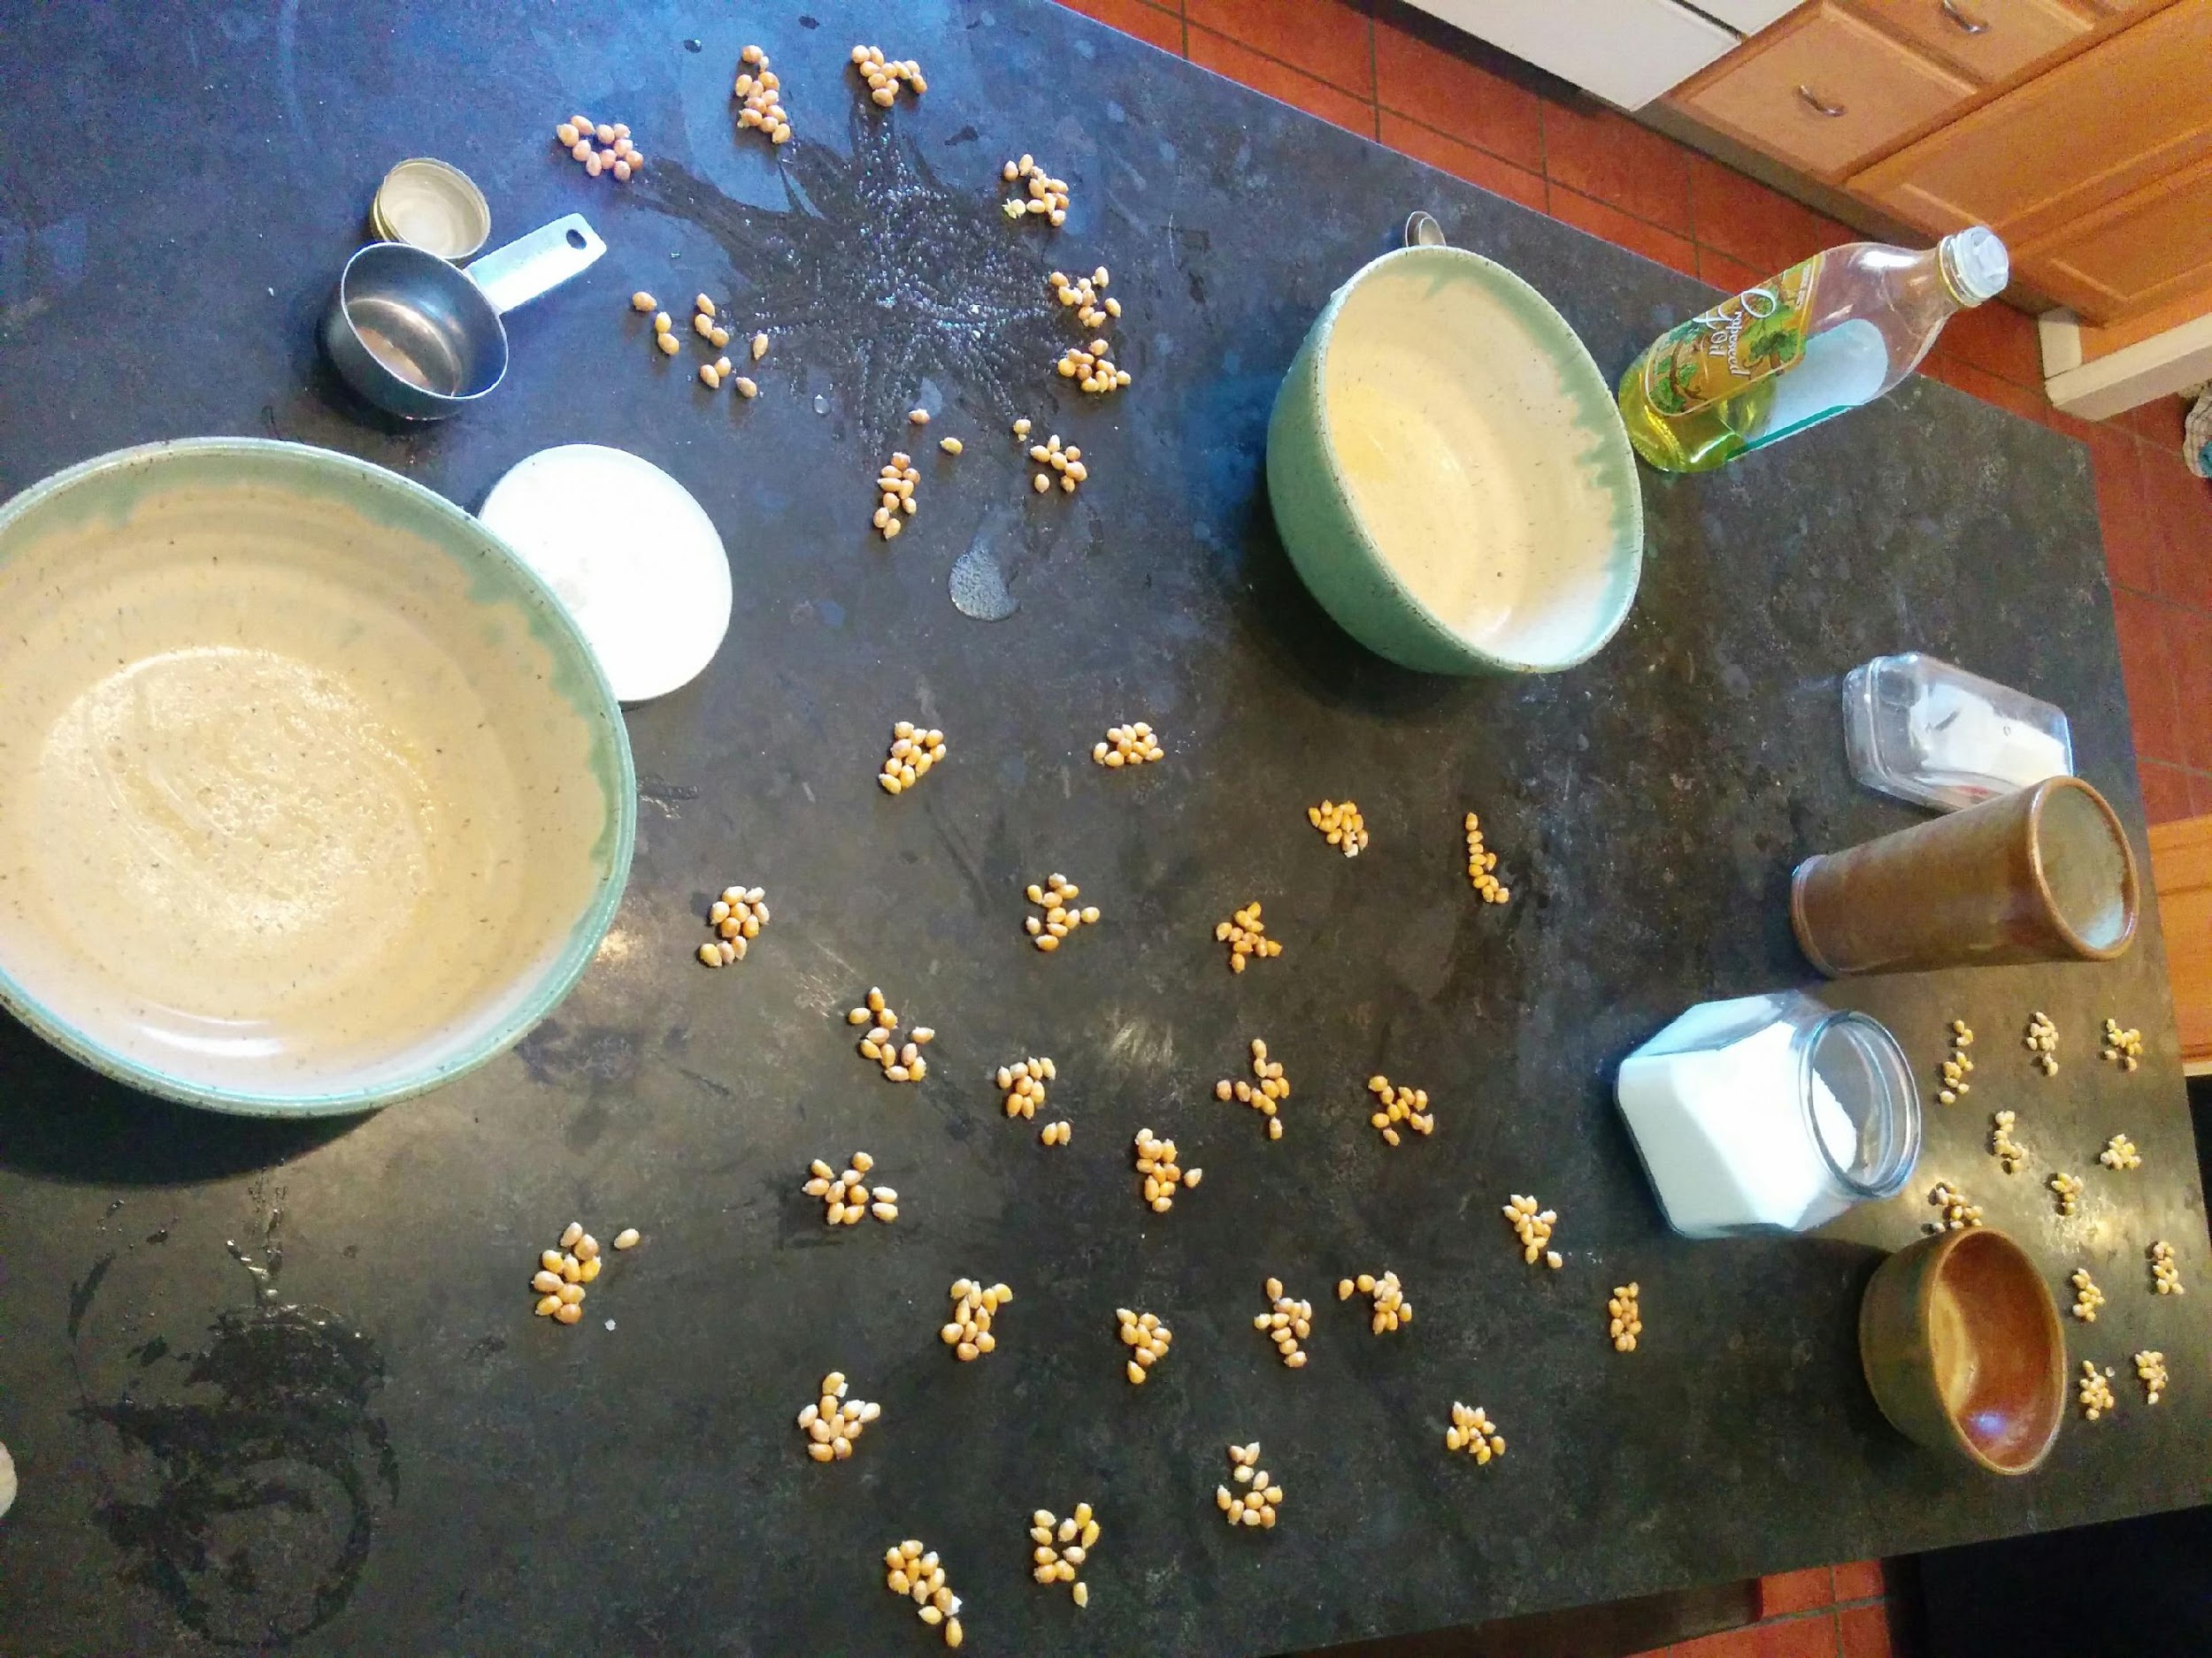
Counting

Slide 14
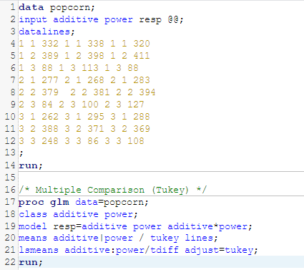
SAS Code

Slide 15

Conclusions
Additive didn’t make a difference (unexpected)
MOAR POWR == MOAR KORN (expected)
Large differences in microwaves (unexpected)
Other factors may play significant role such as microwave design

Slide 16

Recommendations (The Best Recipe)
¼ cup kernels
paper bag
1 tbsp fat for flavor* (optional), salt
~1.5 minutes on high (until popping stops)
* be careful not to burn butter

